Slide 1
KNOWLEDGE BOOSTER
Prepared By :
Bhabajyoti Kalita (B.Sc. 6th Sem)
Guide : Mr. Prity Prakash Deb Sharma

Slide 2
CONTENTS
Introduction
Motivation
Language Used
Objective
ER Diagram
Features
Specifications
Snapshots
Conclusion
Future Scope
Reference

Slide 3
InTRODUCTION
Knowledge Booster deals with the learners to enhance the quality of learning and meet their learning style or needs. It will improve the efficiency and effectiveness and also improve user-accessibility and time flexibility to engage learners in the learning process. Knowledge Booster also provides the facility of quiz for the users own evaluation of certain topics. Anybody can simply login and learn any topics they want and gain knowledge.
Moreover,if the users wants to test themselves, they have the option of online quiz on different topics. Basically the aim is to create a positive environment where people can learn various topics. The quiz portal gives the site that extra push to make it even more interesting.

Slide 4
MOTIVATION
“Knowledge Booster” is website developed for learners to learn several topics and gain knowledge. Basically the aim is to create a positive environment where people can learn various topics. The quiz portal gives the site that extra push to make it even more interesting.

Slide 5
Language Used
HTML
CSS
Javascript
PHP My SQL

Slide 6
OBJECTIVE
The aim of this project is to enhance the quality of learning and meet the learners learning style or needs. It will improve the efficiency and effectiveness and also improve user-accessibility and time flexibility to engage learners in the learning process.
The users can learn various topics and gain knowledge.
The users can attempt quiz on different topics and see their results

Slide 7
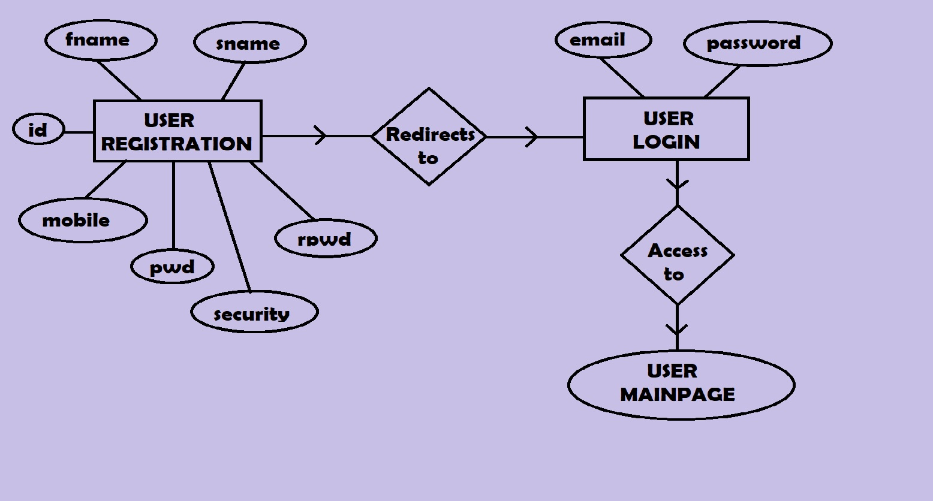
ER DIAGRAM

Slide 8
FEATURES
It saves time and money.
It leads to better retention.
It is consistent.
It is scalable.
It offers personalization.
User friendly.

Slide 9
Specifications
Hardware
Processor: Pentium level or Higher
RAM: 512MB or Higher
Stable Internet Connection
Software
Operating System: Windows/Linux
XAMPP / WAMP Server
Browsers such as: Chrome, Firefox, Opera
Database: PHP MySQL

Slide 10
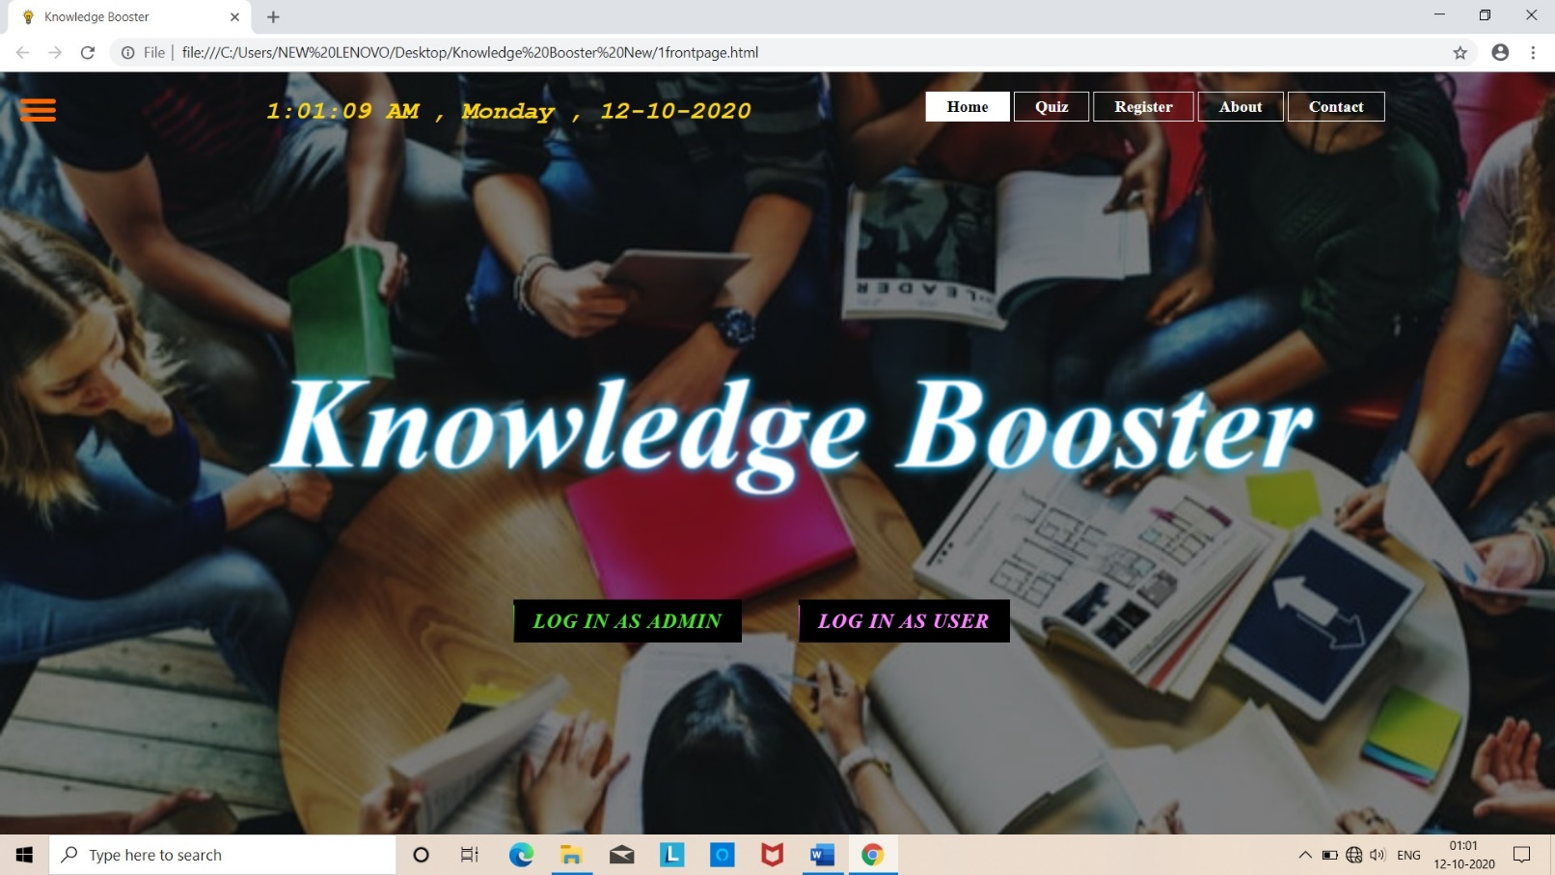
SNAPSHOTS

Slide 11
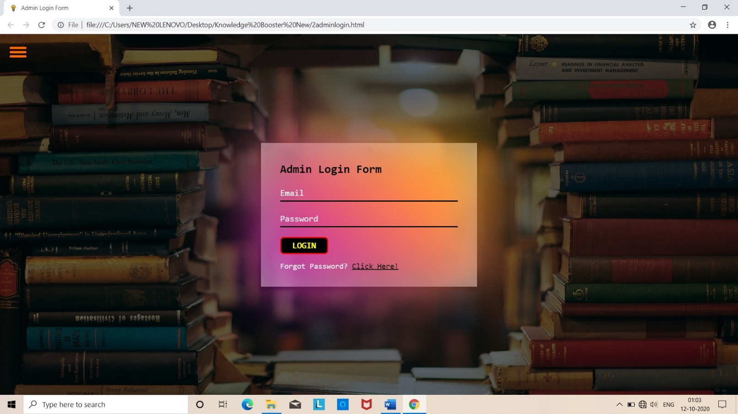

Slide 12
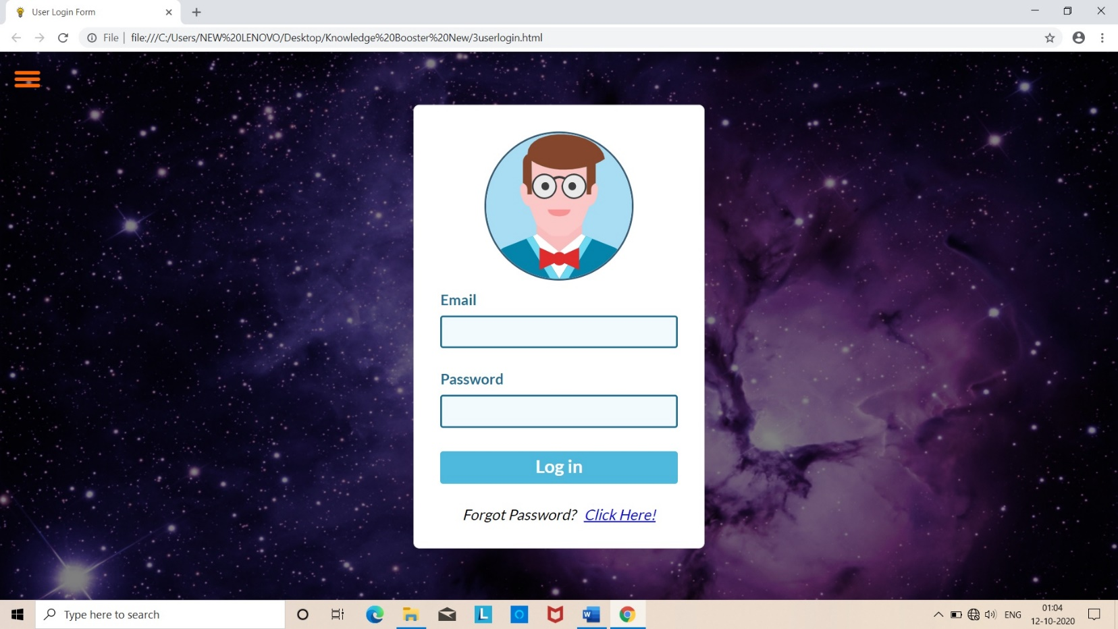

Slide 13
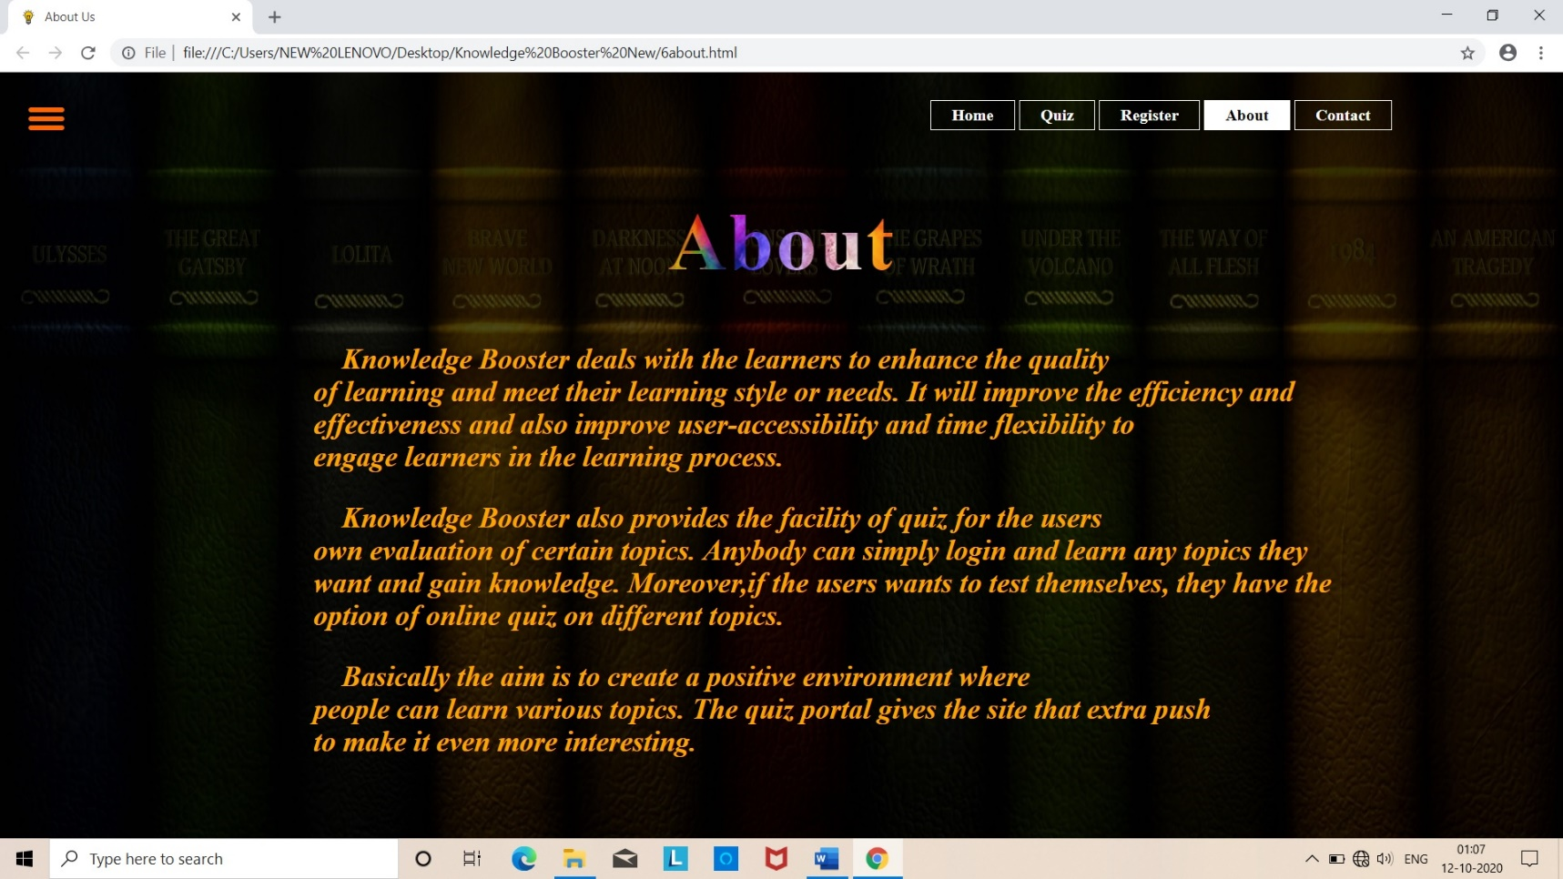

Slide 14
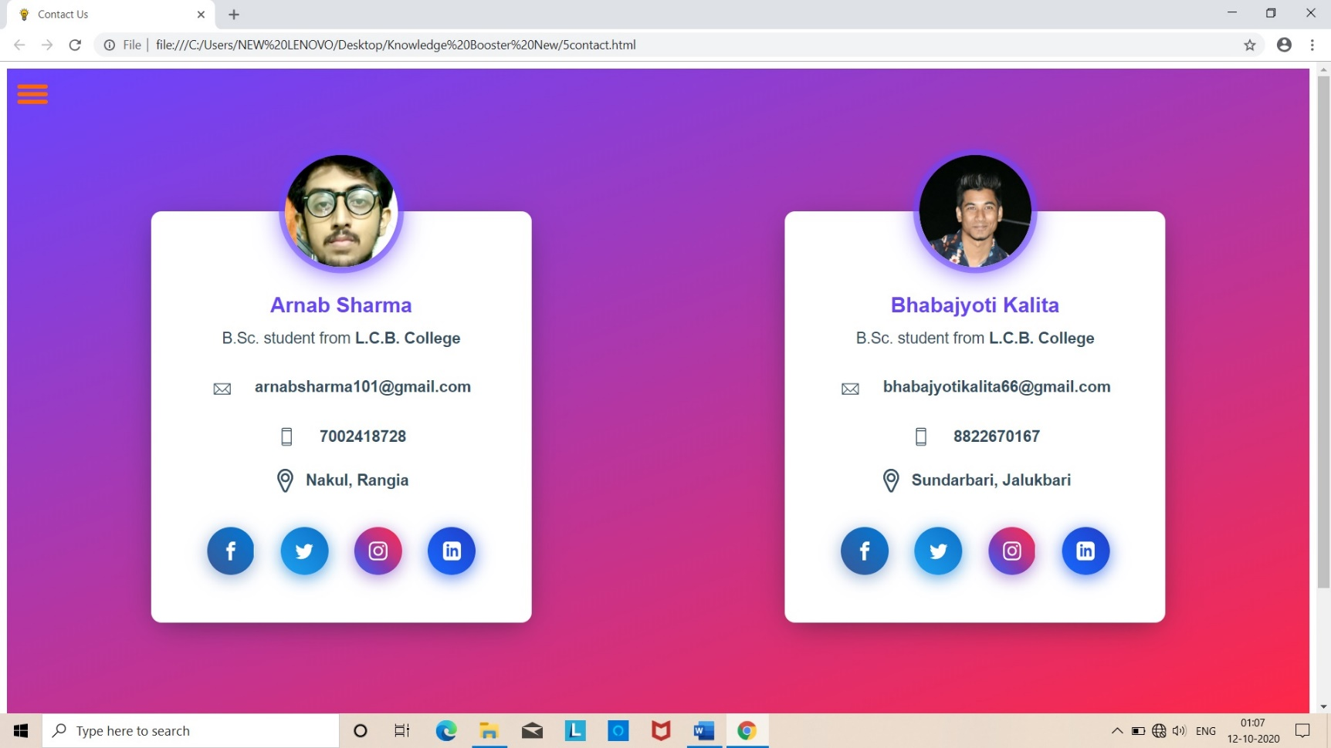

Slide 15
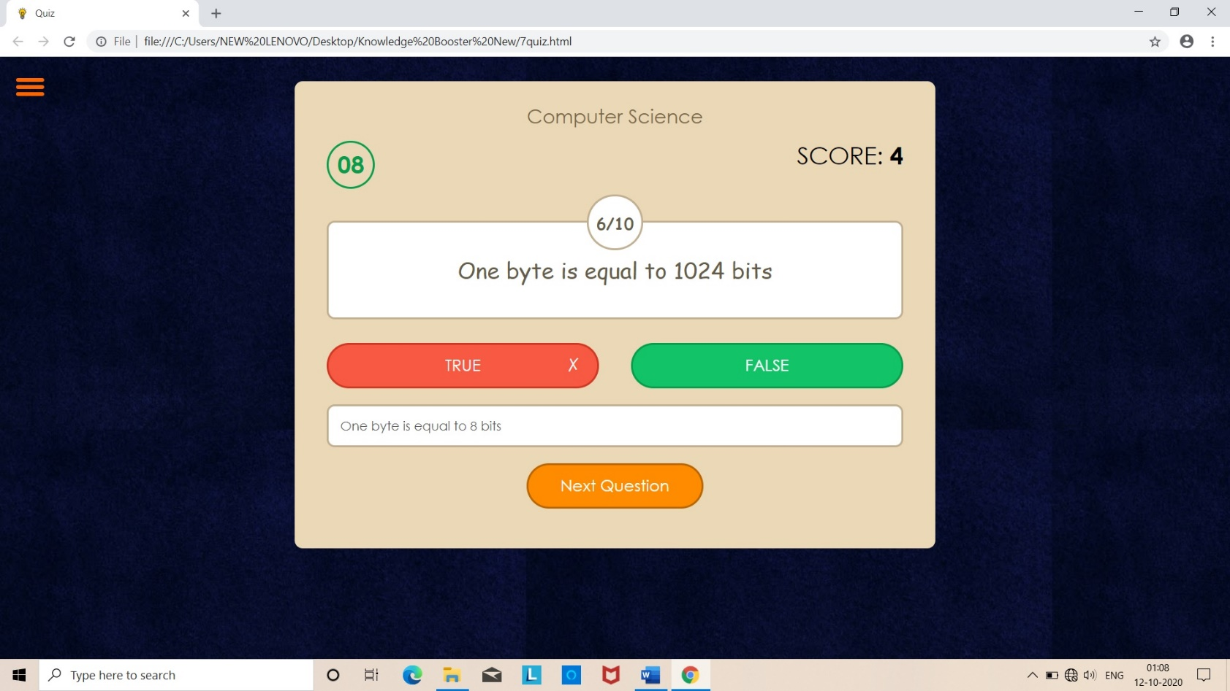

Slide 16
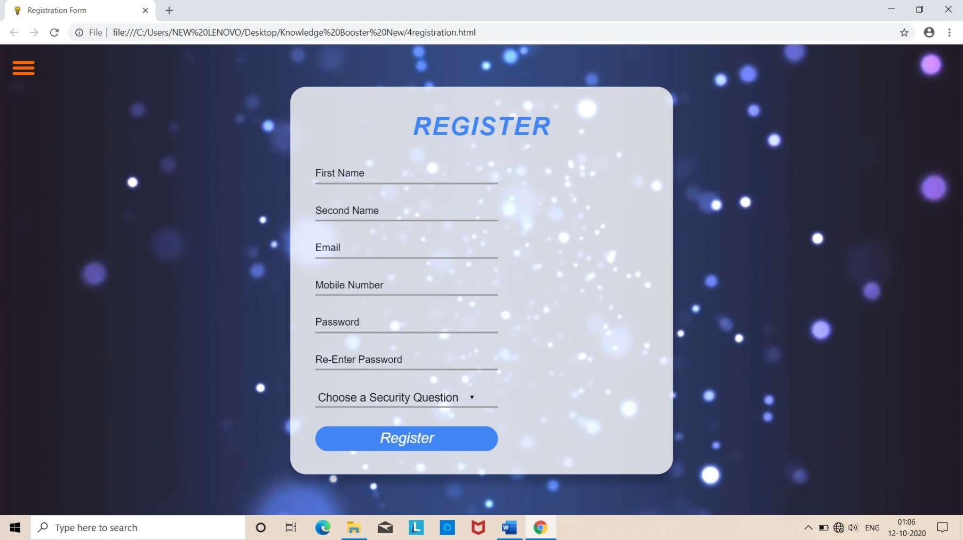

Slide 17
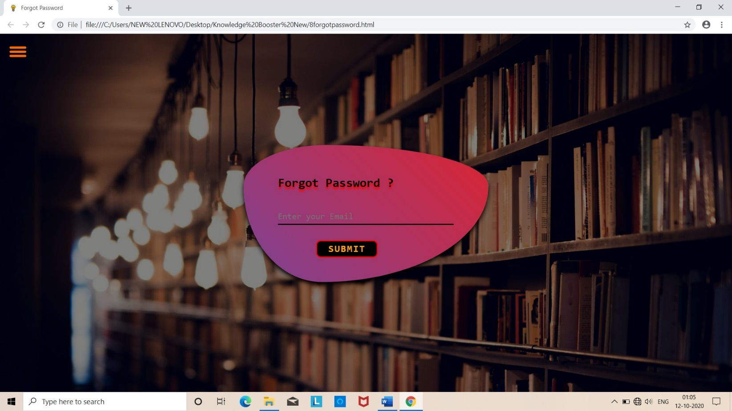

Slide 18
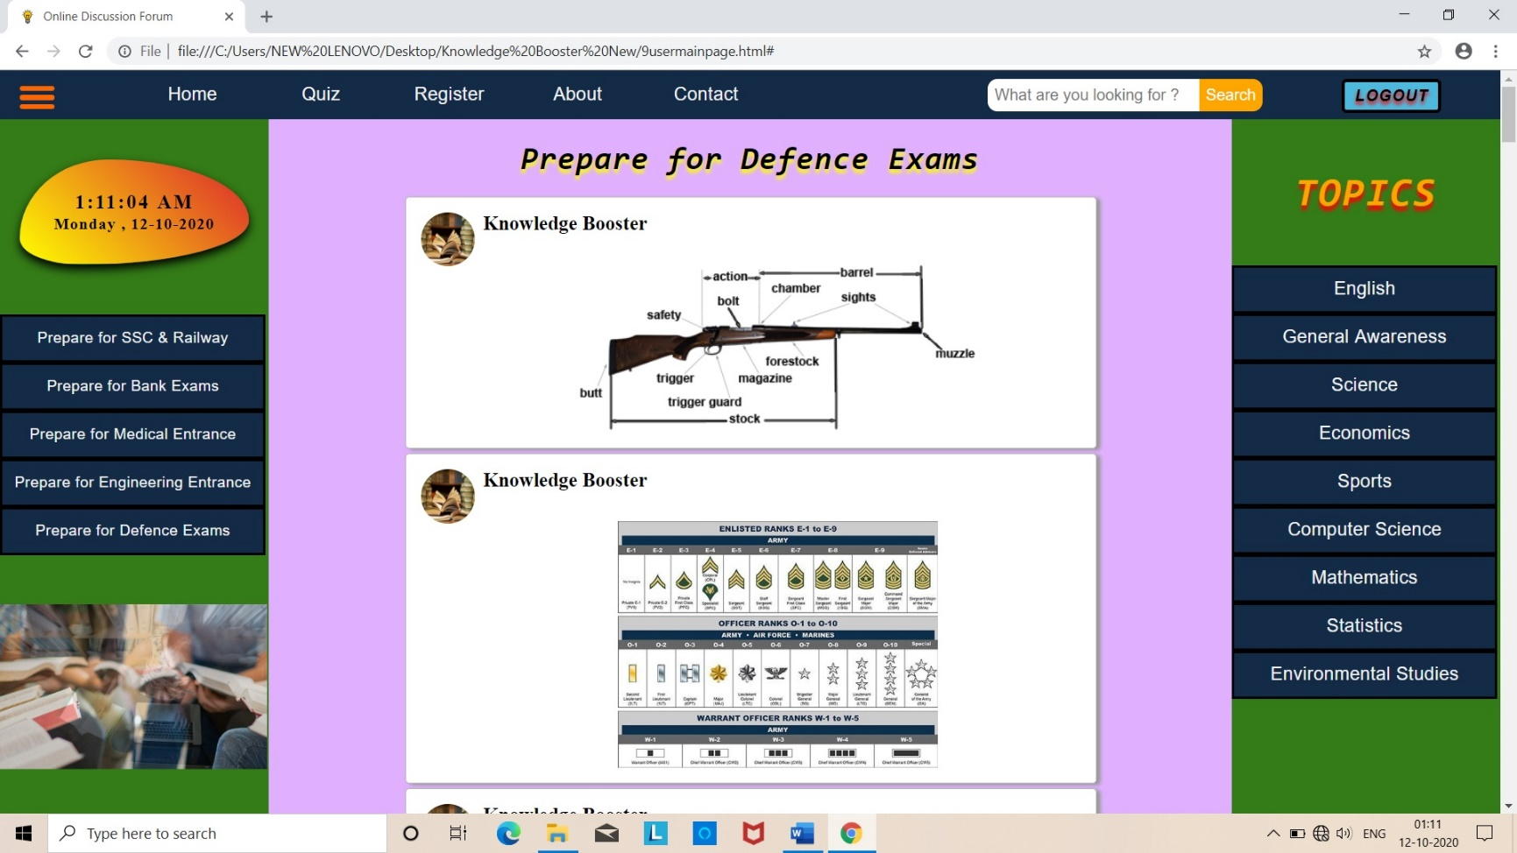

Slide 19
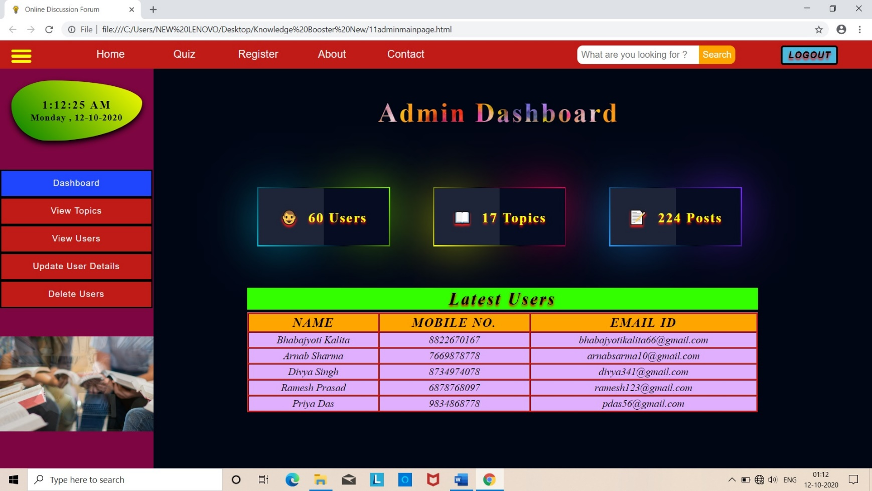

Slide 20
CONCLUSION
To conclude, Project Data Grid works like a component which can access all the databases and picks up different functions. It overcomes the many limitations incorporated in learning.
Easy implementation Environment
Generate quiz report Flexibly

Slide 21
FUTURE SCOPE
The project has a very vast scope in future. The project can be implemented on intranet in future. Project can be updated in near future as and when requirement for the same arises, as it is very flexible in terms of expansion. With the proposed software of database Space Manager ready and fully functional the client is now able to manage and hence run the entire work in a much better, accurate and error free manner. The following are the future scope for the project:
Live claases can be included.
The project can be extended to Discussion Forum
Online mock tests can be included on certain days

Slide 22
REFERENCE
w3school.com
tutorialspoint.com
geeksforgeeks.org
php.net
getbootstrap.com
stackoverflow.com

Slide 23
Thank You

